Slide 1
FluencyForge
Formerly Triolingo
Ethan Schillinger, H. Jacob Schenck, Joe Vossel

Slide 2
CONTENTS
Project Overview
Sprint Backlog
Website Demo
Sprint 3

Slide 3
Project Overview
Reminder of what we’re doing

Slide 4
Project Overview
Language learning app for non-beginners
Standard unit structure
Practice forming your own thoughts/ideas
Specialized scenarios

Slide 5
Sprint Backlog
Accomplishments and challenges

Slide 6
Sprint Backlog
Accomplishments
Completed and polished website framework
Added robust chat framework
Began populating unit content
Challenges
Dealing with bad python chatbots
Bootstrap tooltips. I hate them

Slide 7
Website Demo
Work to date

Slide 8
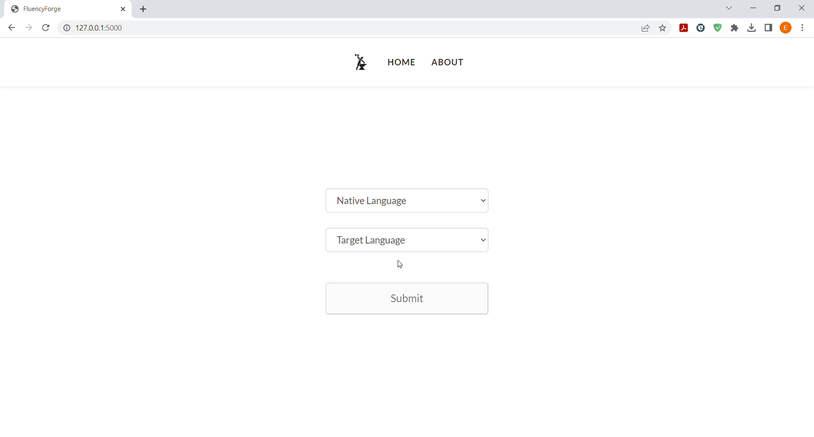

Slide 9
Conversations
What’s changed?

Slide 10
Conversations
Time/Space
Performance
Solution
Training/updating the model requires over an hour
The training file is significantly larger than GitHub allows
Simply not good
Would not benefit someone trying to learn a new language
We are not natural language ML experts
Specialized scenarios are hard to accomplish
Our savior, ChatGPT
Can prompt to fit scenarios
Handles grading fairly well

Slide 11
Sprint 3
Features we aim to implement

Slide 12
Sprint 3
Set up GPT 3.5 API and integrate
More unit content
Polish up website

Slide 13
Thank You
Ethan Schillinger
Jacob Schenck
Joe Vossel

